Slide 1
TMA881 – Simon Jacobsson
Using intrinsics to further optimize Assignment 2
Notes:
My plan is to use x86 intrinsics to further optimize assignment 2. Specifically the 3D distance function.

Slide 2
The Problem
Running perf on cell_distances tells me more than 50 % of the cpu-cycles are spent in the distance() method
This method does the same thing a lot of times, can it be vectorized?
Notes:
By using the perf tool on my program, I can see that alot of time is spent calculating the distances between my 3-vectors, implemented in the assignment using 16-bit integers but I will for this presentation consider an implementation using 32-bit integers since there is more architecture for that.
This method is executed something like ordo(nbr_cells^2). So a relevant question is: does the distance function lend itself to vector intrinsics?

Slide 3
The Problem
Operations +, -, and * are performed
As well as conversion from integer to float, sqrtf(), and then conversion back to integer
Notes:
The method consists of three arithmetic operations, +, -, and *. The + is "horizontal" while the - and * are "vertical" with respect to the 3-vectors. Also, a conversion to float is performed since we are not that picky about about precision and the float sqrtf method is much faster than the integer square root method.

Slide 4
First approach
Vectorizing along the 3-vector
Easy to implement and black box
Obvious inefficiency since 3 is odd
Notes:
The first approach is vectorizing the operations along the 3-vector. This is fairly easy to implement and is possible to implement without modifying the behaviour of the distance function. So if this would be a speed-up it would be very portable. The downside is the outlook, it's probably not efficient since 3 is an odd number, we'd have to pack it into a 4-vector, constantly discarding the last element.

Slide 5
First approach
__m128i _mm_sub_epi32(__m128i a, __m128i b)
__m128i _mm_mul_epi32(__m128i a, __m128i b)
Notes:
With this approach, we get to utilize two intrinsic SIMD instructions, for - and for *. Since the register is 128-bit (hence 128i, i for int), we can pack 4 32-bit integers in there (hence the p in epi).
The top one, for example, compiles directly to the assembler command PSUBD (and some MOV) which does indeed subtract two vectors of 4 32-bit integers.
So then I implemented these in C and benchmarked them with Celero

Slide 6
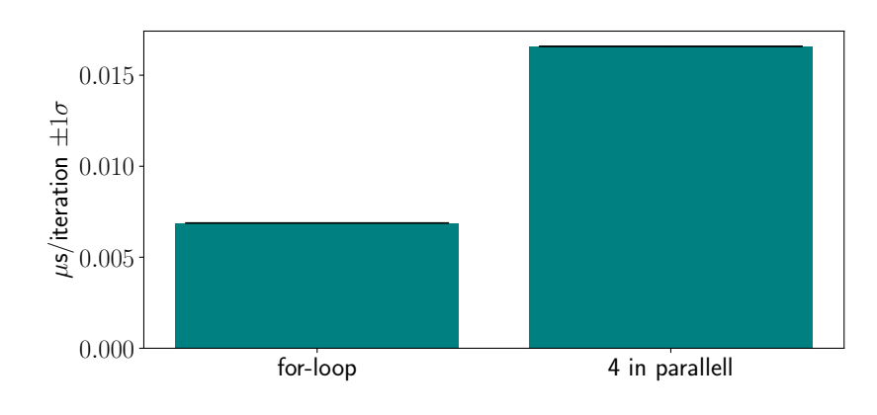
First approach
Notes:
Here is the result.
The for-loop here is just a normal implementation without any intrinsics. It's fairly conclusive that this approach is not a winning strategy.

Slide 7
Second approach
Vectorizing along the list of 3-vector
Slightly harder to implement
Not possible to black box
Added cost of transposing list of 3-vectors
Potentially much more efficient
Notes:
The second approach is more promising though. If we vectorize along the list of 3-vectors, we won't have the same problem with underpacking as with the first approach.
This approach does although force us to rewrite code outside of the distance function too in order to account for the operations being performed in batches. Which makes it not very portable.
Also, since the list of 3-vectors in assignment 2 stores them as columns, we will have to perform a transpose in order to get to the vectors we want to operate on.
But this approach is still much more promising than the first one.

Slide 8
Second approach
__m128i _mm_sub_epi32(__m128i a, __m128i b)
__m128i _mm_mul_epi32(__m128i a, __m128i b)
__m128i _mm_add_epi32(__m128i a, __m128i b)
__m128 _mm_cvtepi32_ps(__m128i a)
__m128 _mm_sqrt_ps(__m128 a)
Notes:
Mainly, I think, due to this giving us three more operations that can be vectorized: +, conversion, and the square root. The s in ps stands for short, i.e. a 32-bit float.

Slide 9
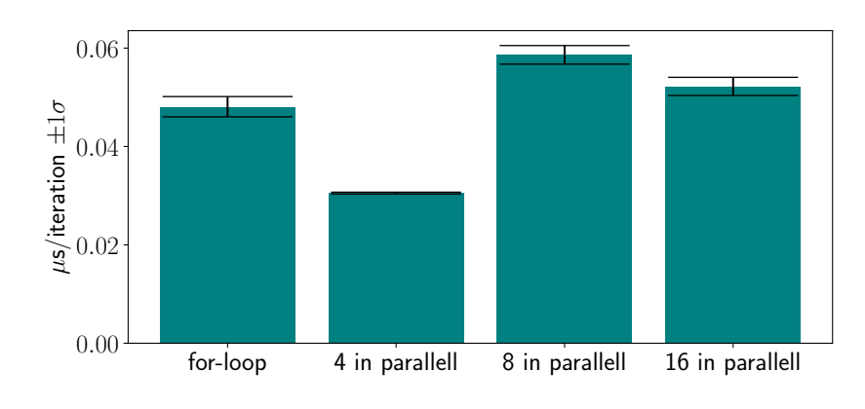
Second approach
Notes:
And we see in the results that we indeed get a speed-up. Around 35 %.
I did try some other sizes also to see what would happen. My hypothesis was that since we already filled the registers to the brim, the only thing affecting the speed would be the transpose which is ordo(n^2). But the last one here goes down, which I have no good explanation for. So I guess that's why it's important to just try out different stuff and see what's fastest.

Slide 10
Conclusion
Vectorizing along 3-vector was not faster :(
Vectorizing along list was faster :)
Notes:
In conclusion, vectorizing along the 3-vectors was not faster, while vectorizing along the list was indeed faster.
This could sadly not have been used to its full potential in assignment 2 since there one significant speed-up came from realizing we only needed 16-bit integers to represent our fixed-point numbers and there does not seem to exist the same intrinsic functions for 8 packed 16-bit integers.

